Slide 1
Stock Portfolio
By Prachi Singh
(IMPETUS)

Slide 2
Agenda
Introduction
User Stories
Technology Stack
4+1 View
Data Model
Sonar Report Snapshot
Application Demo

Slide 3
Introduction
What is Stock Portfolio Management ?
StockPortfolio is an online stock portfolio analysis system.
It gives
Performance review,
Manages your assets(stocks),
Current stats anytime you need it.

Slide 4
Agenda of Site
What Stock Portfolio Management offers you?
Search for a stock.
See Stock prices of the company.
Add the stock to his portfolio and track it.
User can set alert of a tracked company and if it varies by x% defined by the user, the user will get an alert on email configured.
User can see the graph of the variation of stock price for a year, a day or selected interval of time for a selected stock.

Slide 5
Use Cases
Register
Login
View Graph
Update Portfolio
Search by Ticker Symbol or company name
Track Stocks
Can get password on email id if user forgot his password
Logout

Slide 6
Technology Stack
Framework | Struts-2.3.4.1
Web Server | Jetty-6.1
Database | MYSQL -5.5
Building tool | Apache maven-3.0.4
Unit Testing Tool | Junit -4.8.1
Logging Tool | Log4j -1.2.15
ORM –Tool | Hibernate -3.6.0
Chart | Jfreechart-1.0.1
UML Tool | Umlet-11.5.1

Slide 7
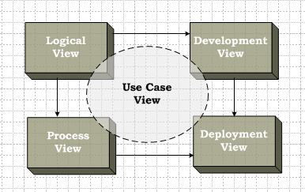
4+1 View

Slide 8
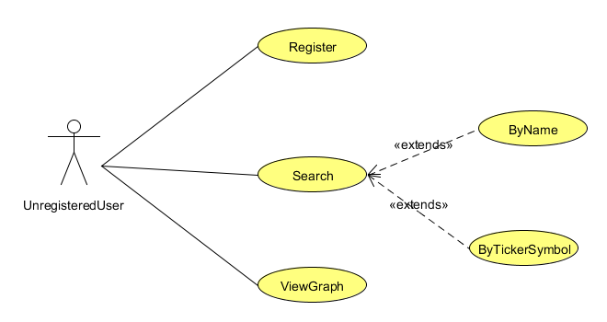
Use Case Diagram
Use case for unregistered user →

Slide 9
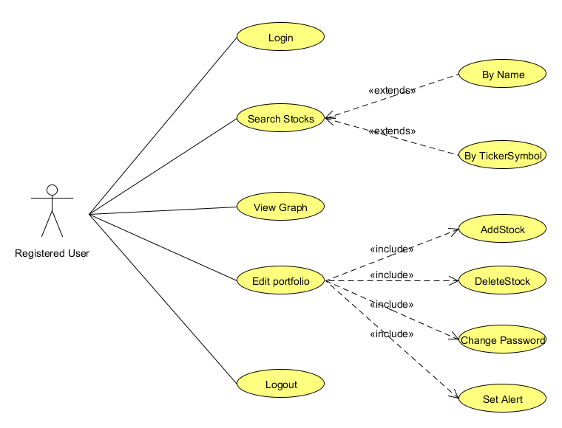
Use Case Diagram
Use case for Registered user →

Slide 10
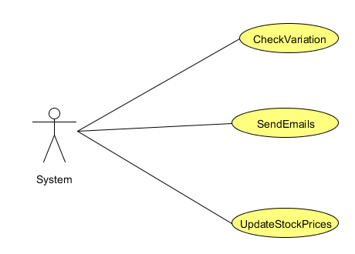
Use Case Diagram
Use case for System →

Slide 11
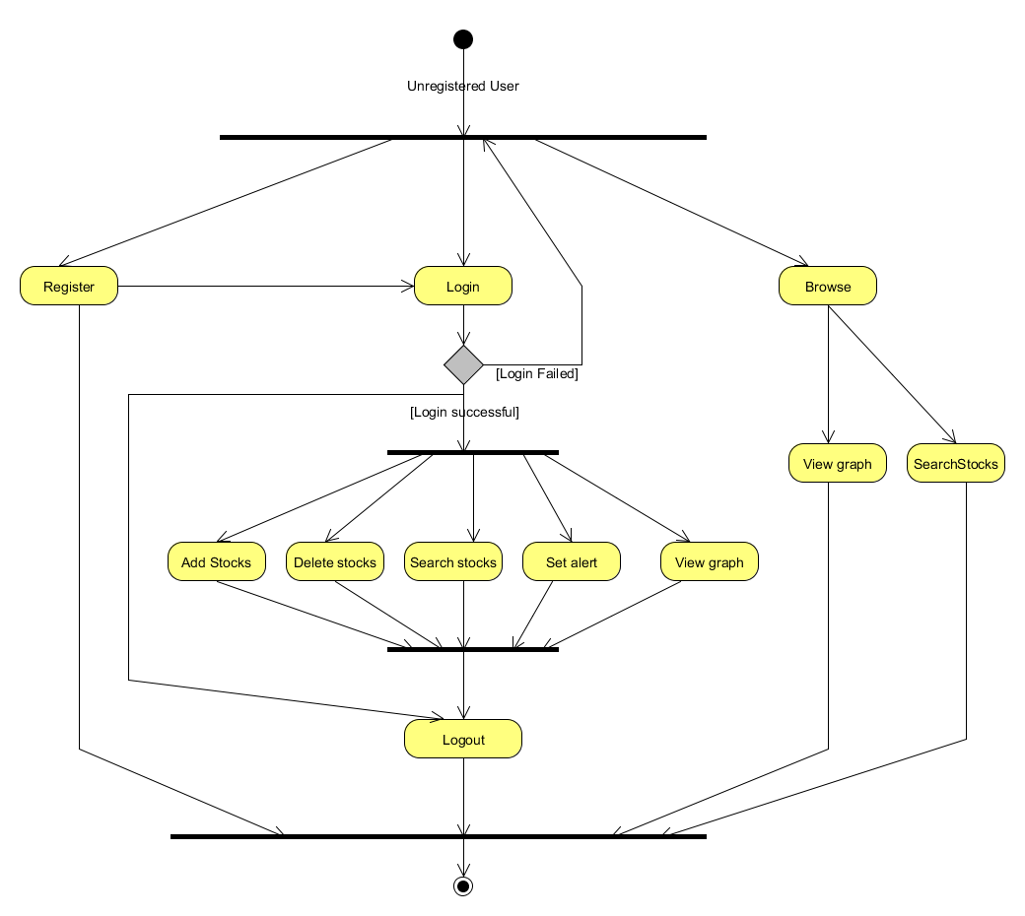
4+1 Views :Process view- Activity diagram

Slide 12
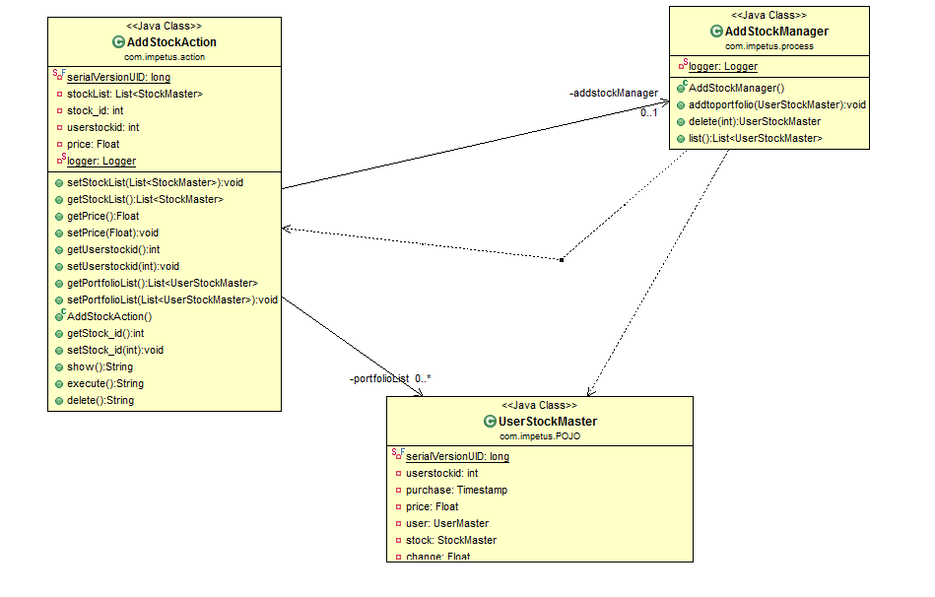
4+1 View: Logical View- Class diagram
Class diagram for Add Stock action→

Slide 13
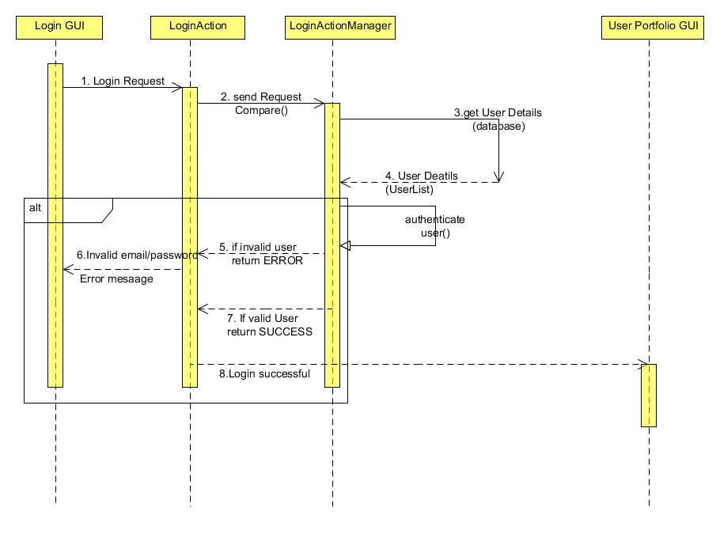
Sequence Diagram
For Login Action-----

Slide 14
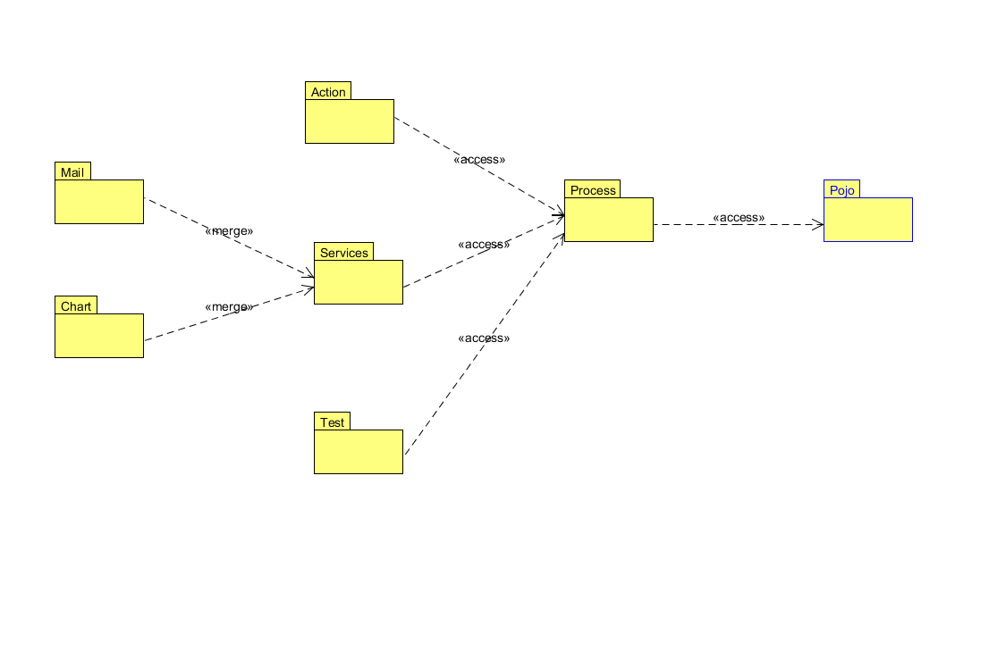
4+1 Views: Development view
Package Diagram

Slide 15
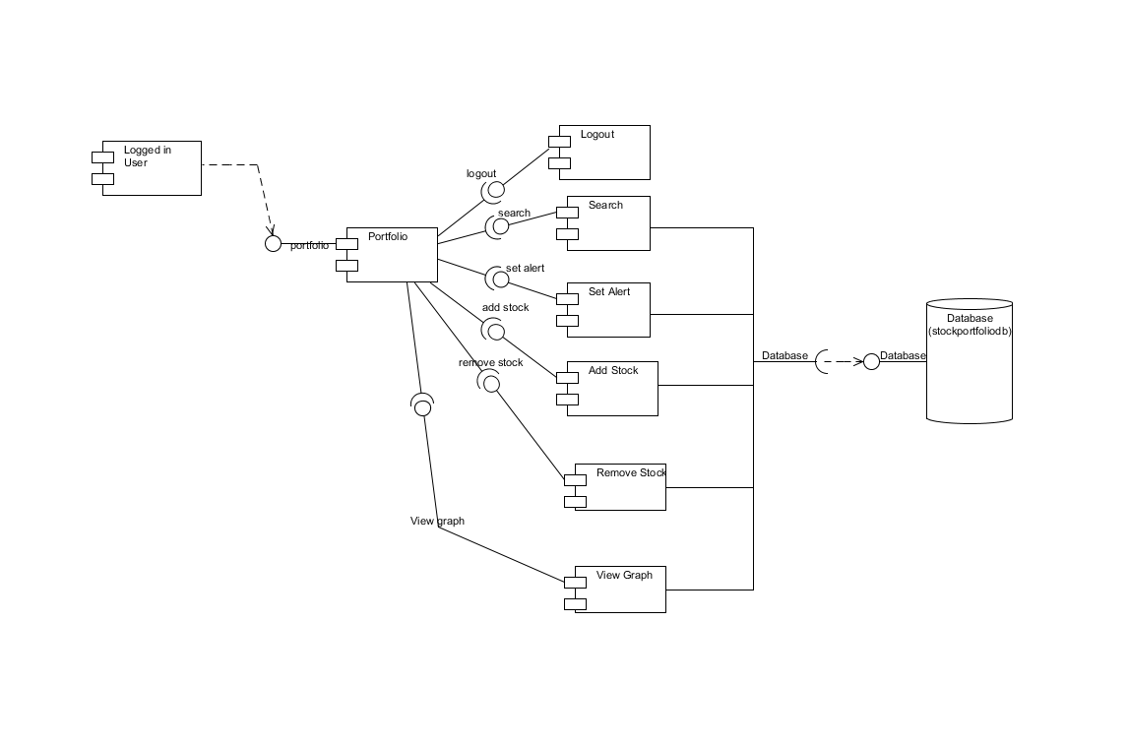
4+1 Views: Development view
Component Diagram

Slide 16
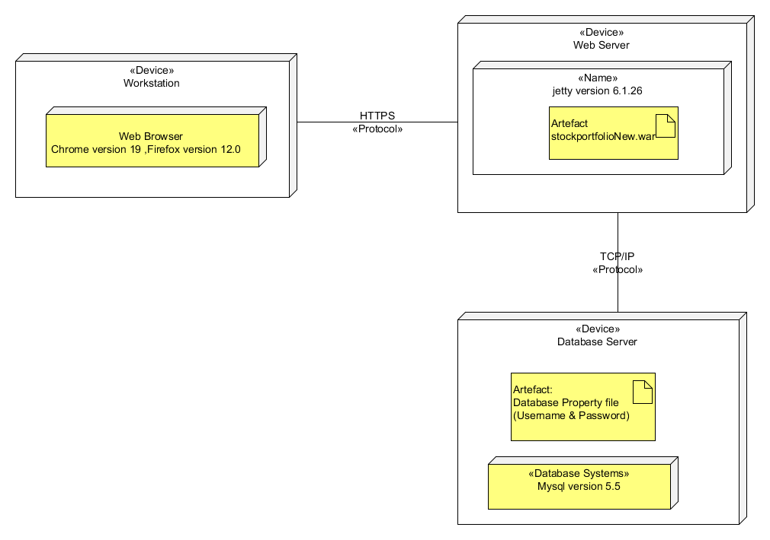
4+1 View: Physical View
Deployment Diagram

Slide 17
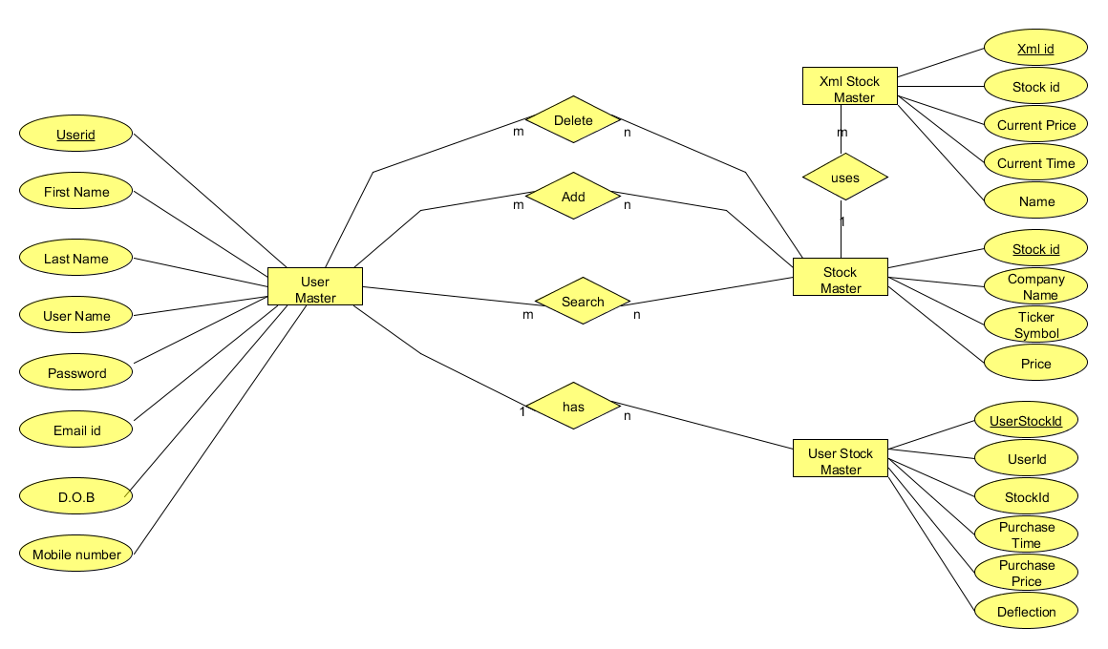
Data Model
ER Diagram

Slide 18
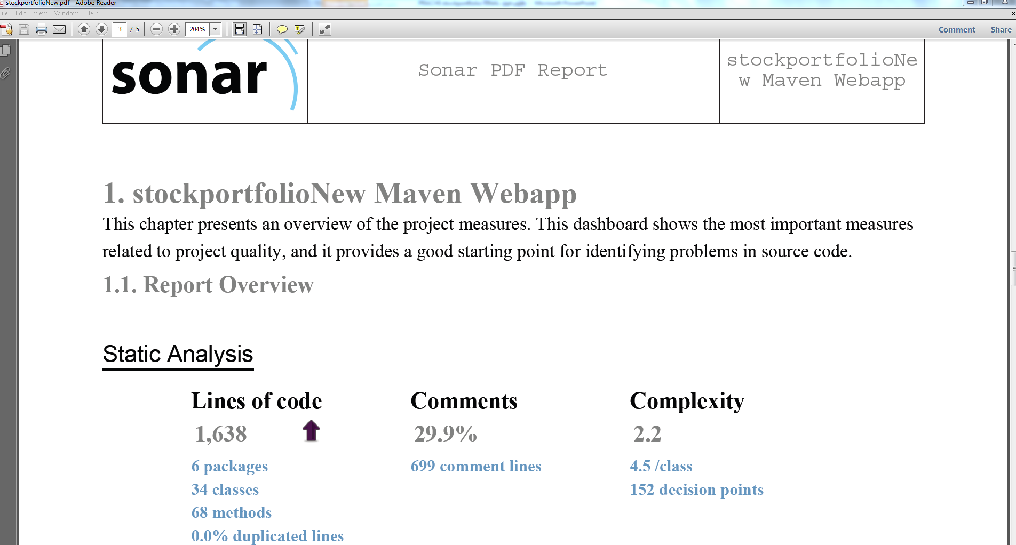
Sonar Report Snapshot

Slide 19
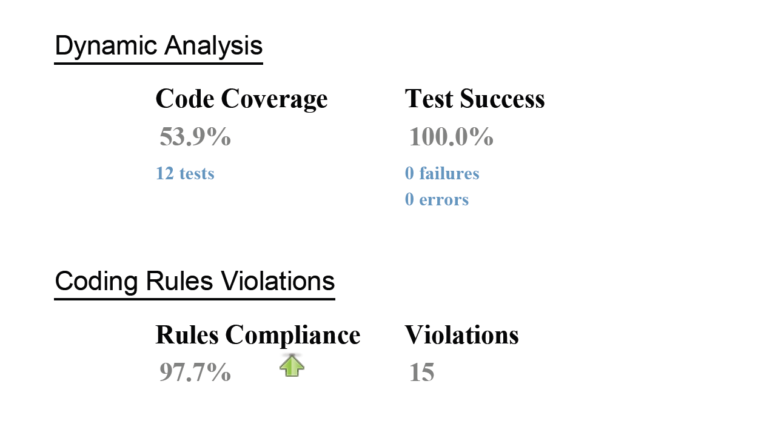
Sonar Report Snapshot

Slide 20
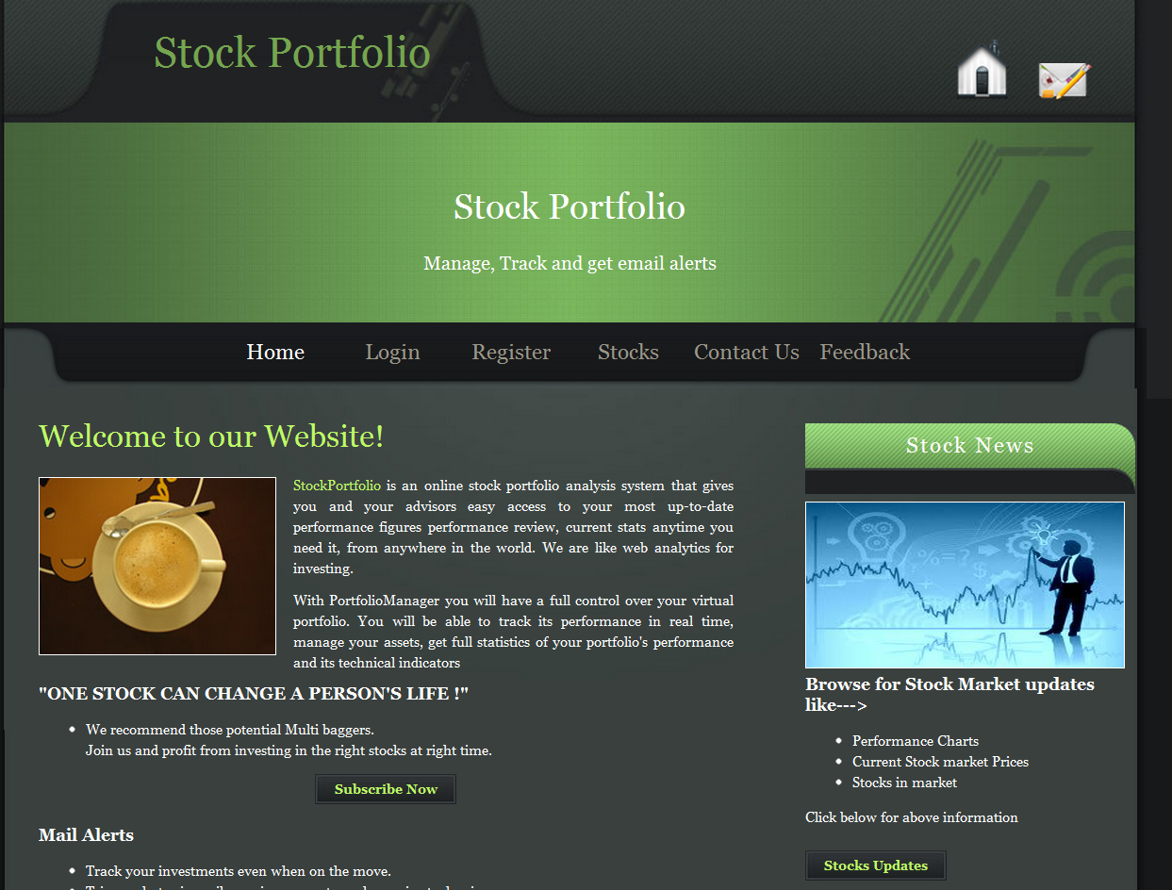
Application Snapshots
Home Page of application----

Slide 21
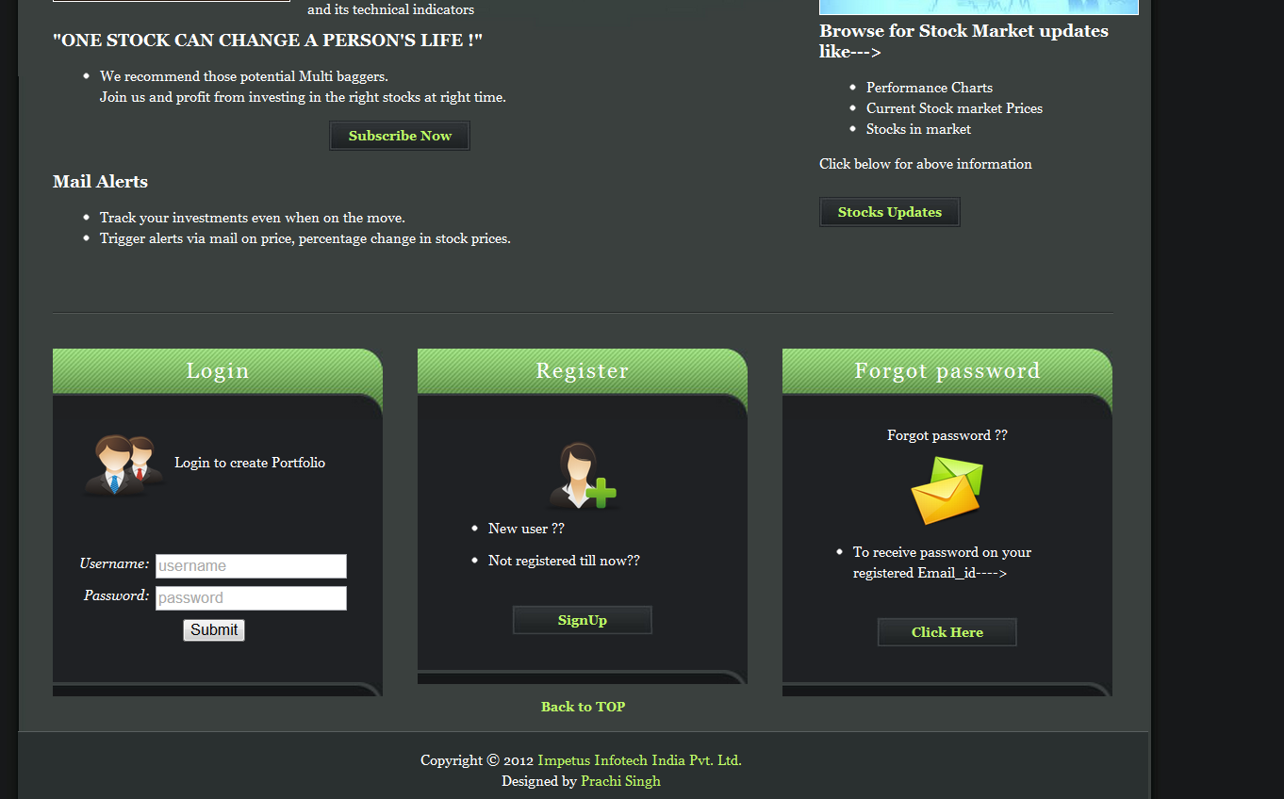
Application Snapshots
Login and Register modules---

Slide 22
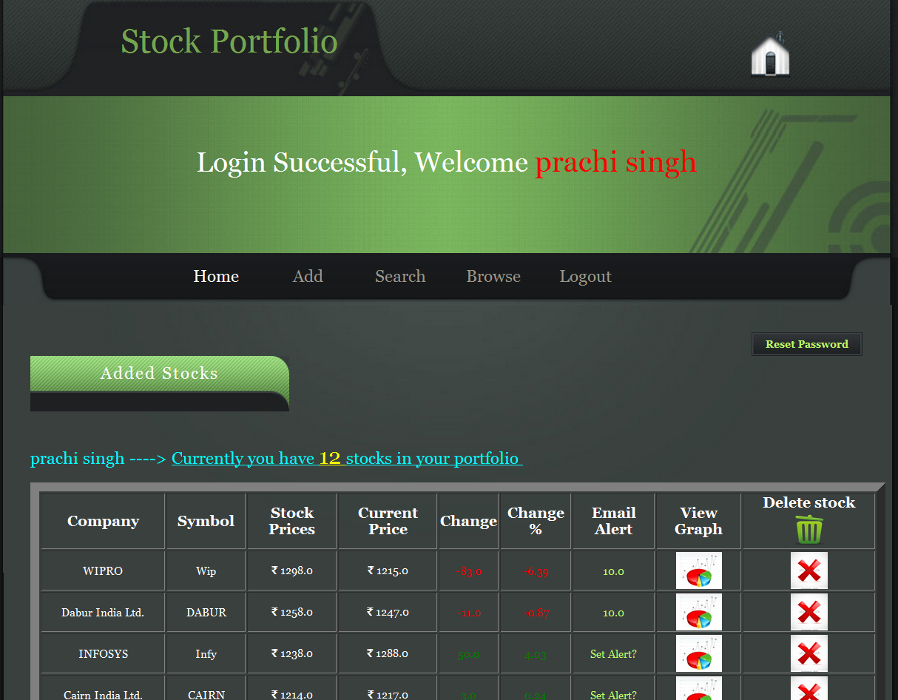
Application Snapshots
Portfolio Page of a Registered user ---

Slide 23
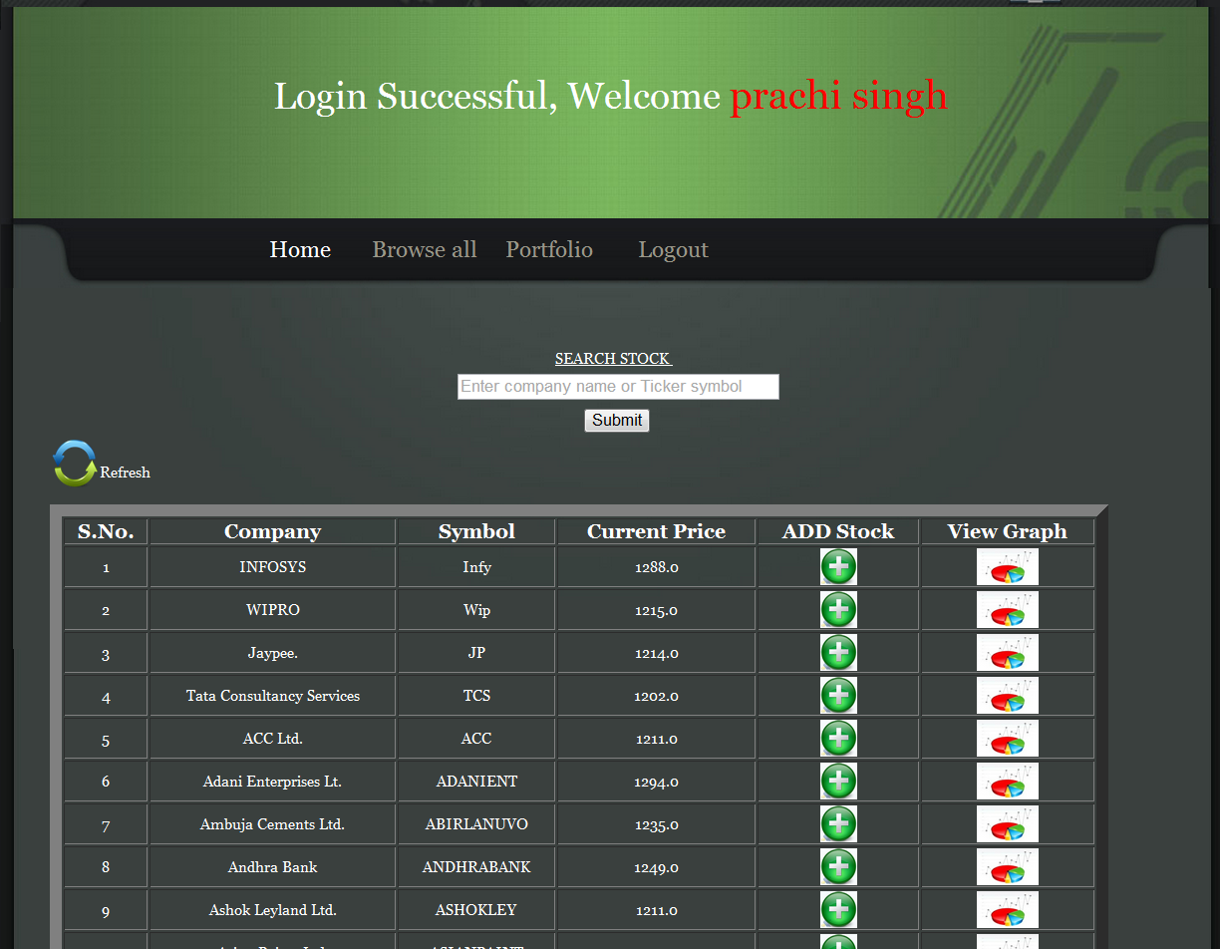
Application Snapshots
Search Page ---

Slide 24
End
THANK YOU

